Slide 1
ISRAEL PALESTINE WAR ANALYSIS
MIP-NLP-01
PROJECT-02

Slide 2
Abstract
Project Overview
Objective: Leverage NLP techniques for sentiment analysis on ISRAEL PALESTINE WAR reddit data.
Approach: Predict sentiments and trends using NLP tools and machine learning algorithms.
Audience: Aimed at cricket enthusiasts, sports analysts, and marketers for a nuanced understanding of social media dynamics.

Slide 3
Problem Statement
Challenges Addressed
NLP Techniques:
Utilizing NLP to extract sentiment, trending topics, and user engagement from ISRAEL PALESTINE WAR reddit data.
Predictive Models:
Building models that analyze tweet contents, user profiles, and metadata to anticipate sentiments and trends.
Influential Features:
Identifying key features and factors influencing sentiments and trends in ISRAEL PALESTINE WAR reddit data.
Model Accuracy:
Assessing the accuracy and reliability of NLP-based predictive models for sporting event tweets.

Slide 4
Dataset Information
Dataset Overview
Contents: ISRAEL PALESTINE WAR reddit data, including 'comment_id', 'score', 'self_text', 'subreddit', 'created_time'.
Purpose: Comprehensive source for training and evaluating predictive models in social media analysis.

Slide 5
Sentiment Analysis with VaderSentiment
VaderSentiment Library
Methodology:
Leveraging VADER for sentiment analysis based on compound scores.
Binary polarity assignment with a threshold of 0.1.

Slide 6
Text Preprocessing
Text Cleaning Steps
Lowercasing: Convert all text to lowercase for consistency.
Removing URLs: Eliminate web links to focus on textual content.
Removing @usernames: Exclude mentions to ensure user anonymity.
Removing Punctuations: Enhance tokenization accuracy by eliminating punctuation.
Tokenizing Words: Break down text into individual words for analysis.
Removing Stop Words: Exclude common words that don't contribute to sentiment.
Lemmatizing Words: Reduce words to their base form for uniformity.

Slide 7
Text Tokenization and Padding
Tokenization and Padding
Tokenization:
Utilizing Keras Tokenizer for converting text into numerical tokens.
Padding Sequences:
Ensuring uniform length for sequences using Keras pad_sequences.

Slide 8
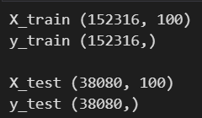
Data Splitting
Train-Test Split
Split Ratio: 80% training, 20% testing.
Random State: Set to 42 for reproducibility.

Slide 9
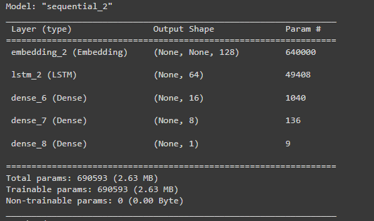
LSTM Model Building
Model Architecture
Embedding Layer:
Mapping words to dense vectors.
LSTM Layer:
Capturing long-term dependencies in tweet sequences.
Dense Layers:
Neural network layers for classification.
Optimizer and Loss:
Adam optimizer with binary crossentropy loss.

Slide 10
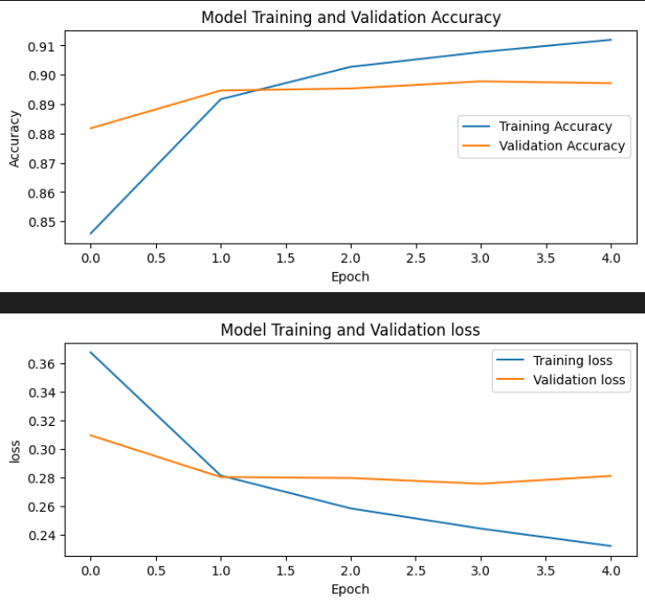
Model Training
Training Process
Epochs: 14.
Batch Size: 64.
Validation Data: Used to monitor and prevent overfitting with EarlyStopping callback.

Slide 11
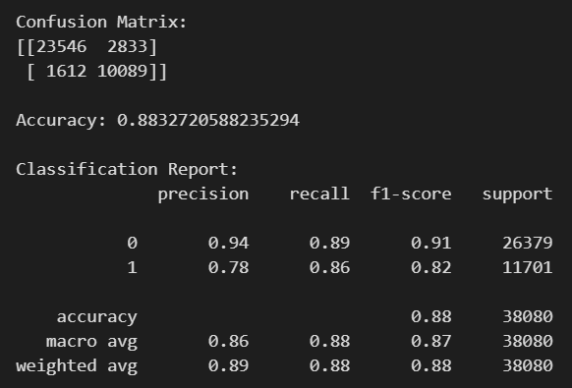
Model Evaluation
Evaluation Metrics
Confusion Matrix:
Illustrates true positives, true negatives, false positives, and false negatives.
Accuracy Score:
The ratio of correctly predicted instances to the total instances.
Classification Report:
Precision, recall, and F1-score for each class

Slide 12
Thank You!

